Slide 1
Machine Learning Mini Project
Online Fraud Detection using classification model
Shih Ting Ting, Tammy
My Code in Google Colab

Slide 2
Project Details
Project Title: Online Fraud Detection using classification model
Project Objectives:
The goal of the project is to build the Machine learning models to predict The ‘Fraud’ or ‘not a fraud Transaction’.
As the world becomes increasingly digitized, so does the threat of online fraud. With billions of transactions taking place daily, individuals, businesses, and financial institutions are constantly at risk of falling victim to malicious actors seeking to exploit vulnerabilities in the digital landscape. However, the battle against online fraud has not been one-sided. Innovative technologies and strategies are emerging to detect and prevent fraudulent activities, making it more challenging for cyber criminals to succeed.
Notes:
隨著我們的世界變得越來越數位化，網路詐騙的威脅也越來越大。
由於每天發生數十億筆交易，個人、企業和金融機構始終面臨著成為試圖利用數位環境中的漏洞的惡意行為者的受害者的風險。
然而，打擊網路詐欺的鬥爭並非一面倒。用於偵測和防止詐欺活動的創新技術和策略不斷湧現，使網路犯罪分子的成功變得更加困難。

Slide 3
Dataset Description
i. Introduction to the dataset
ii. Dataset characteristics (e.g. size, features, class balance)
iii. Data preprocessing steps (if applicable)

Slide 4
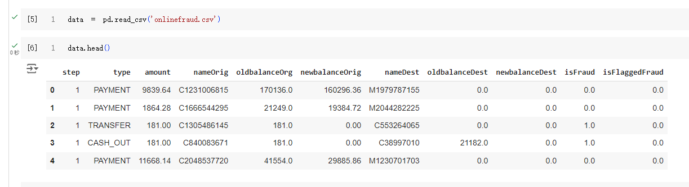
Introduction to the dataset
A dataset containing information about online payment fraud data, so that we can understand what type of transactions lead to fraud. We collected a dataset from Kaggle, which contains historical information about fraudulent and non-fraudulent transactions which can be used to detect fraud in online payments.
Notes:
包含線上支付詐欺資料資訊的資料集，以便我們了解哪些類型的交易導致詐欺。
我們從 Kaggle 收集了一個資料集，其中包含有關欺詐性和非欺詐性交易的歷史信息，可用於檢測線上支付中的詐欺行為。

Slide 5
Dataset characteristics
data.info()
<class 'pandas.core.frame.DataFrame'>
RangeIndex: 6362620 entries, 0 to 6362619
Data columns (total 11 columns):
# Column Dtype
--- ------ -----
0 step int64
1 type object
2 amount float64
3 nameOrig object
4 oldbalanceOrg float64
5 newbalanceOrig float64
6 nameDest object
7 oldbalanceDest float64
8 newbalanceDest float64
9 isFraud int64
10 isFlaggedFraud int64
dtypes: float64(5), int64(3), object(3)
memory usage: 534.0+ MB
step: represents a unit of time where 1 step equals 1 hour
type: type of online transaction
amount: the amount of the transaction
nameOrig: customer starting the transaction
oldbalanceOrg: balance before the transaction
newbalanceOrig: balance after the transaction
nameDest: recipient of the transaction
oldbalanceDest: initial balance of recipient before the transaction
newbalanceDest: the new balance of recipient after the transaction
isFraud: fraud transaction=1, non-fraud transaction=0
Notes:
step：表示時間單位，1步等於1小時
type：線上交易類型
amount：交易金額
nameOrig：開始交易的客戶
oldbalanceOrg：交易前餘額
newbalanceOrig: 交易後餘額
nameDest：交易的接收者
oldbalanceDest：交易前收款人的初始餘額
newbalanceDest：交易後收款人的新餘額
isFraud：詐欺交易=1，非詐欺交易=0

Slide 6
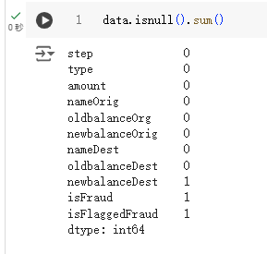
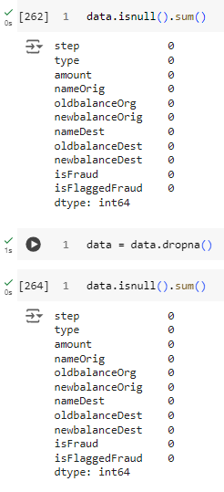
Data preprocessing steps
drop a row with missing value

Slide 7
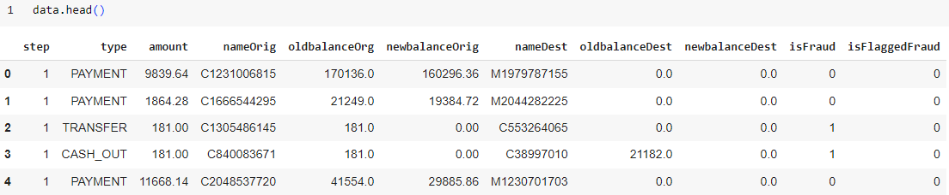
look at “type”
Column “type” is object 🡪 need to change to numeric later because need to use it in training model

Slide 8
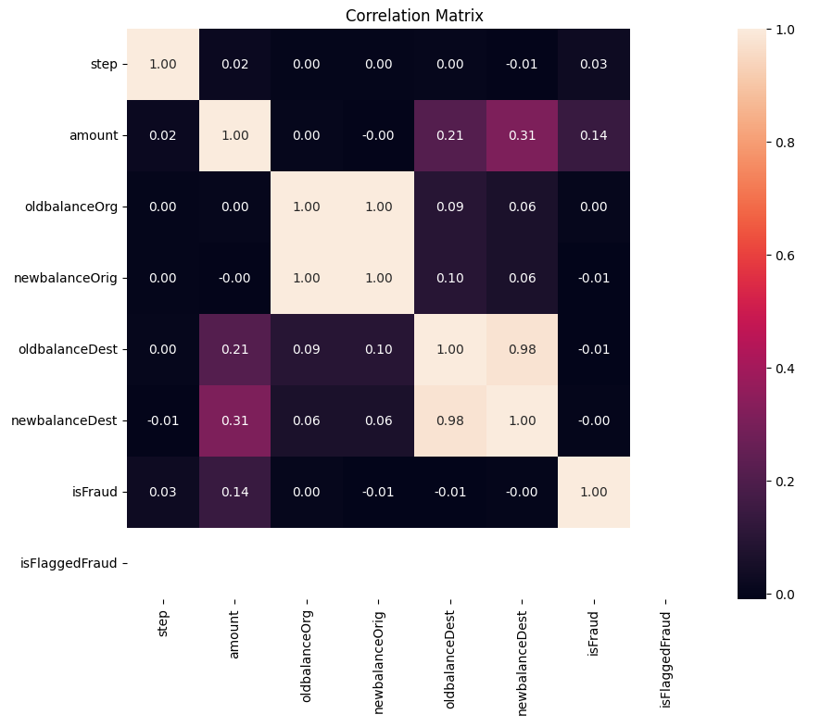
Heatmap
- Correlation Matrix

Slide 9
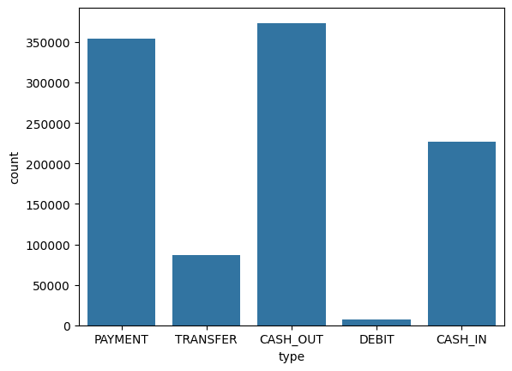
Plot chart to visualize data
Most frequency:
Cash out and payment

Slide 10
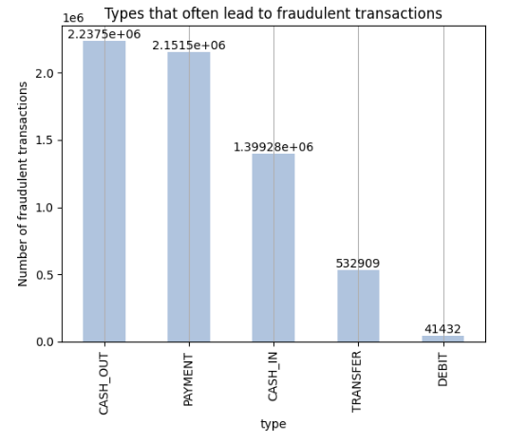
Cash out, Payment

Slide 11
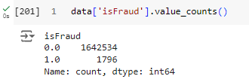

Slide 12
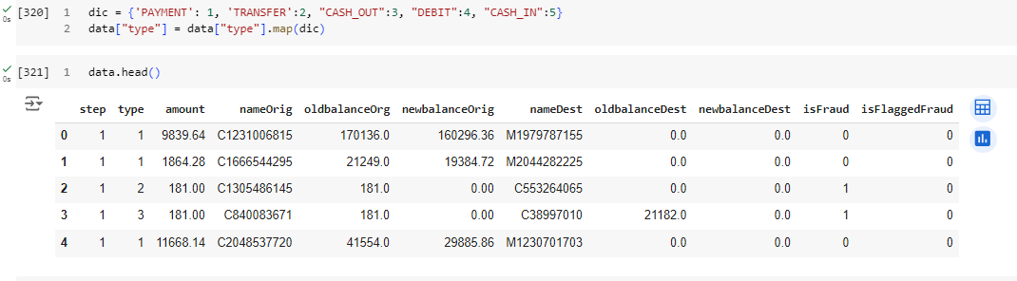
Column “type” is object 🡪 need to change to numeric now

Slide 13
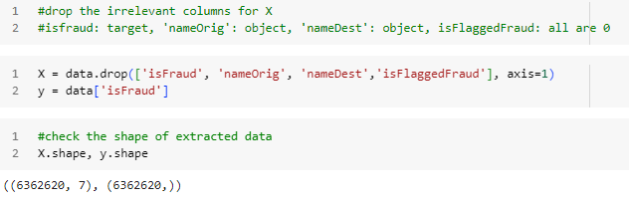
Feature Extraction
Since all the nameOrig & nameDest values are unique and not numeric so there is no point using them as the training model.
Target: “isFraud”

Slide 14
Split data into two parts: Training and Testing
Training size: 0.7 (70%)
Testing size: 0.3 (30%)
Random state: 42
from sklearn.model_selection import train_test_split
X_train, X_test, y_train, y_test = train_test_split(X, y, test_size=0.3, random_state=42)

Slide 15
Methodology
Feature engineering and selection (if applicable)
Description of the machine learning approach(es) used
Model selection and hyperparameter tuning

Slide 16
Machine Learning Models Selection
As the prediction (Fraud/Not Fraud) is a classification problem so the models we will be using are :
LogisticRegression : It predicts that the probability of a given data belongs to the particular category or not.
XGBClassifier : It refers to Gradient Boosted decision trees. In this algorithm, decision trees are created in sequential form and weights are assigned to all the independent variables which are then fed into the decision tree which predicts results. Gradient Boosted Trees grow in a sequential fashion, with each new growth repairing the mistakes of the older one. Gradient Boosted Trees perform well in imbalanced circumstances because of their ability to concentrate on misclassified occurrences through sequential learning.
We would like find a better model so use both LogisticRegression and XGBClassifer model to train.

Slide 17
Train the models
models = [LogisticRegression(), XGBClassifier()]
for i in range(len(models)):
models[i].fit(X_train, y_train)
Train two models at the same time using for loop

Slide 18
Analysis
Results of the machine learning model(s)
Evaluation metrics used (e.g. accuracy, precision, recall)
Visualization of results (if applicable)

Slide 19
Result
LogisticRegression:
Training Accuracy : 0.88739
Validation Accuracy : 0.88499
XGBClassifier
Training Accuracy : 0.99996
Validation Accuracy : 0.99938
for i in range(len(models)):
print(f'{models[i]} : ')
train_preds = models[i].predict_proba(X_train)[:, 1]
print('Training Accuracy : ', ras(y_train, train_preds))
y_preds = models[i].predict_proba(X_test)[:, 1]
print('Validation Accuracy : ', ras(y_test, y_preds))
print()
The best-performed model is XGBClassifier.

Slide 20
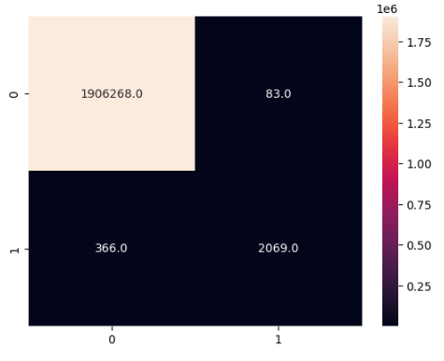
Confusion Matrix
From the confusion matrix:
1906268 were correctly classified as non-fraudulent payments, and 83 were misclassified as non-fraudulent payments.
2069 payments were correctly identified as fraud while 366 payments were incorrectly labelled as fraud.

Slide 21
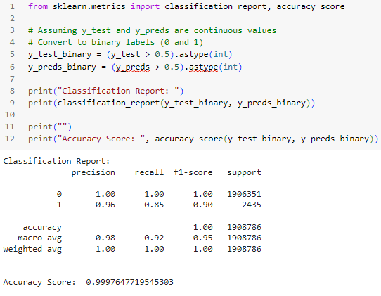
Classification Report
precision
recall
f1-score
support

Slide 22
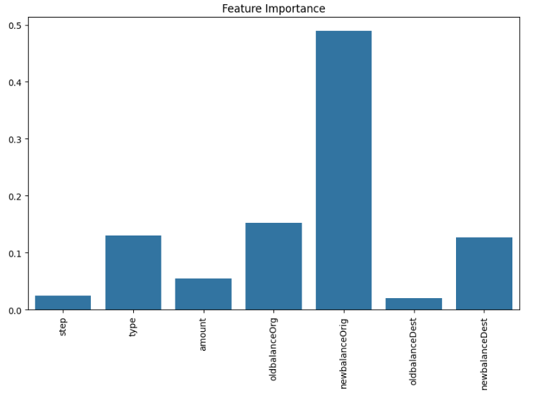
Feature Importance
newbalanceOrig is highest

Slide 23
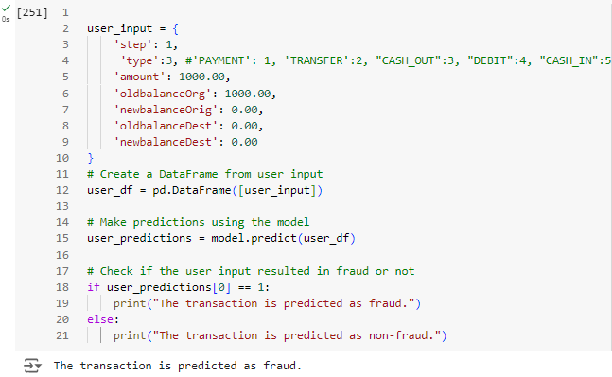
Prediction for new transactions
By entering a new transaction with features value, it will print out the result (Fraud/Non-fraud).
After detected fraud transaction by machine learning model, human can do further investigization on fraud transaction.

Slide 24
Challenges and Limitations
Challenges faced during the project
Need to understand different machine learning models, The difference of different machine learning model. The concept of machine learning technique is complex.
When encountering error in pre-processing, plotting chart and evaluating result, search online for help.
Limitations of the approach or dataset
did not do hyperparameter tuning
Potential areas for future improvement
By training more models to compare
Outlier

Slide 25
Future Work
Description of any additional ideas or approaches that were not implemented
build a prediction system: After enter value of features, the system will automatically determine whether it is fraud transaction or not.
Reasons for not implementing these ideas (e.g. time constraints, complexity)
training more ML models: time constraints, need more training time, too complex
build a prediction system: too complex
Notes:
outlier
overfit, unbalance, resampling

Slide 26
Conclusion
Summary of the project objectives and achievements:
The goal of the project is to build a model to predict The ‘Fraud’ or ‘not a fraud Transaction’.
By performed data analysis, data preprocessing, and data modeling with multiple machine-learning models to achieve this.
Comparing two models, XGBClassifier perform better.
The model is performing very well with the test data.
This project has been a great exercise for us to understand how to apply machine learning into case.
Key takeaways:
have a more understanding of different classification models, how to implement models in a case related to online fraud.
Problem-solving skill: error code/ unclear concept → online resource, ChatGPT

Slide 27
Reference
https://www.kaggle.com/datasets/jainilcoder/online-payment-fraud-detection
https://www.geeksforgeeks.org/online-payment-fraud-detection-using-machine-learning-in-python/?ref=lbp
https://medium.com/@gauravchordiya.ds/the-problem-of-detecting-online-fraud-in-transactions-using-machine-learning-models-55e2885e9328
https://www.geeksforgeeks.org/handling-imbalanced-data-for-classification/

